Slide 1
PRODUCT RESEARCH
BY: NOURE HAMMOUDE

Slide 2
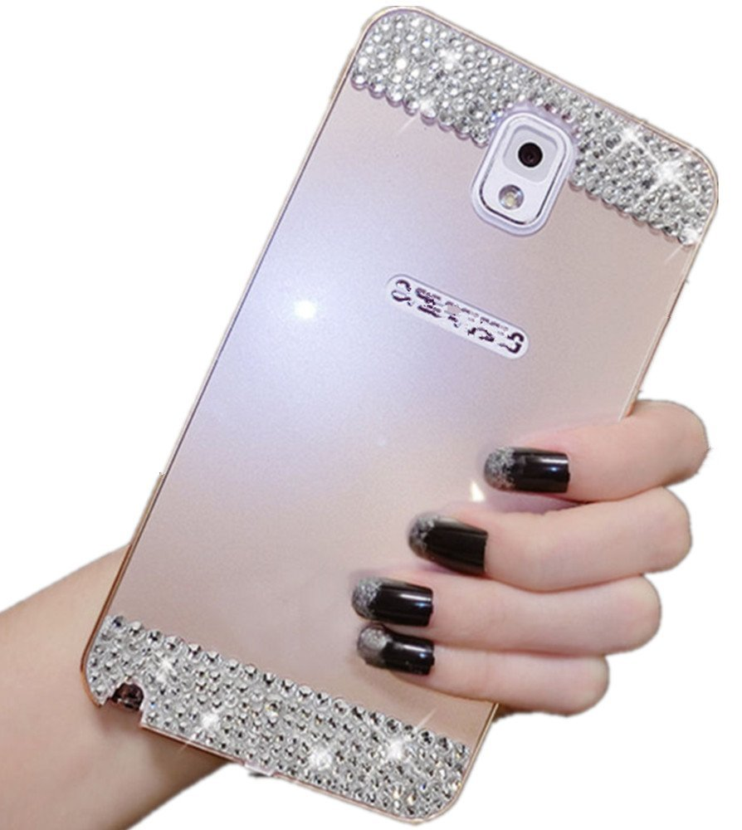
Luxury Aluminum Ultra-thin Metal Case Cover for Samsung Galaxy S5 I9600 (Gold)
Price Range: $4.50 - $10.99 Product Specs:
. DEMAND FACTORS
- Fashion design
- It comes with 3 color
. SUPPLY FACTORS
- cheap material
- 100% Brand New
. ELASTICITY
When the price decrease, people will like it and buy it.

Slide 3
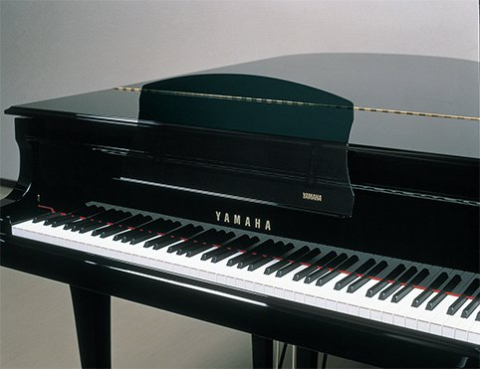
YAMAHA Music Rests for Grand Piano PGF2
Price Range: $230.5 - $250.00 Product Specs
. DEMANDS FACTORS
-adjustable for height with 4 step
- Fun
. SUPPLY FACTORS
-not for condition of opening roof
- 620(W) x 45(D) x 270(H)mm
. ELASICITY
- This is an elastic product, people buy to be a musician.

Slide 4
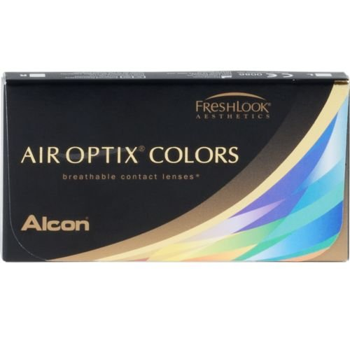
Air Optix Colors Green Contact Lenses (6 lenses/box - 1 box)
Price Range: $82.00 - $100.00 Product Specs
.DEMAND FACTORS
- 6 colored lenses
- WATER % OF CONTENT: 55%
.SUPPLY FACTORS
-comfortable lenses you love
- Monthly disposable colored contact lenses
. ELASTICITY
People like to use to change their style and get new look.

Slide 5
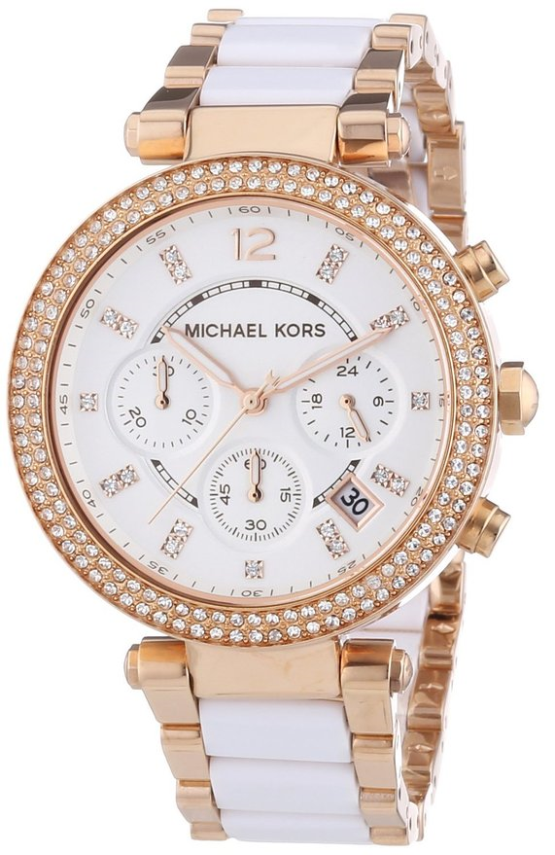
Michael Kors Watches Parker Watch (White/Rose Gold)
Price Range: $189.99 - $ 200.00 Product Specs
.DEMAND FACTORS
- Three-Hand
-Imported
. SUPPLY FACTORS
- Case Size: 39MM
- Case Thickness: 12MM
. ELASICITY
-This is an elastic product, when the price increase more they will buy something else.

Slide 6
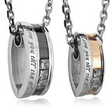
Men, Women's "Love you till the end" 2PCS Stainless Steel Pendant Necklace CZ Silver Gold Black Valentine's Couples His & Hers Set-with 20 and 23 inch Chain (with Gift Bag)
Price Range: $13.00 - $35.00 Product Spec
. DEMAND FACTORS
- High quality Jewelry
- Discover the INBLUE Collection of jewelry
. SUPPLY FACTORS
- Size: 0.59 x 0.91 inch
- Silver and Leather
. ELASICITY
-This is an elastic products, people still buy it

Slide 7
. Sexy Fashion Women's Platform Pumps Strappy Buckle Stiletto High Heels Shoes
Price Range: $22.00 - $39.00 Products Spec
. DEMAND FACTORS
-It’s attractive
- girls like it
. SUPPLY FACTORS
- Condition:100% Brand NEW
- Heel Height:14cm
.ELASICITY
- It is an elastic product, when the price increase people will pay something's else

Slide 8
Maybelline The Colossal Kajal Eyeliner Pencil - Black
Price Range: $ 5.00 – $10.00 Product Spec
. DEMAND FACTORS
- Stay up to 12 H
- look amazing
. SUPPLY FACTORS
- last for long
- comes in a trendy retractable stick
. ELASICITY
- It is an elastic product, People still buy it.

Slide 9
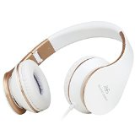
Sound Intone I65 2015 New Stereo Over-ear Headphones, Foldable Headset with In-line Volume Control Microphone for Mp3,mp4,pc,tablet,most Smartphone (White/gold)
Price Range: $17.99 - $30.00 Product Spec
. DEMAND FACTORES
- High precision 40mm magnetic neodymium driver
- High quality
SUPPLY FACTORS
- comfortable for long time wear
- provide extra flexibility
. ELASICITY
It is an elastic product, when the price increase people will look for something else

Slide 10
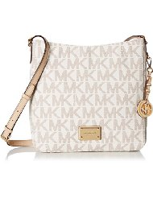
MICHAEL Michael Kors Jet Set Travel Large Messenger Vanilla
Price Range $144.00 - $250.00 Products Spec
DEMAND FACTORS
- It’s attractive
- high quality
SUPPLY FATORS
- leather with fabric lining
- zipper Closure
. ELASICITY
It is an elastic product, people don’t buy it if the price high.

